Slide 1
Principles of Marketing
Kotler and Armstrong
Insert
Textbook
Cover Image
Chapter 11:
Pricing Strategies
Additional Considerations
Copyright © 2016 Pearson Education, Inc.
11-1

Slide 2
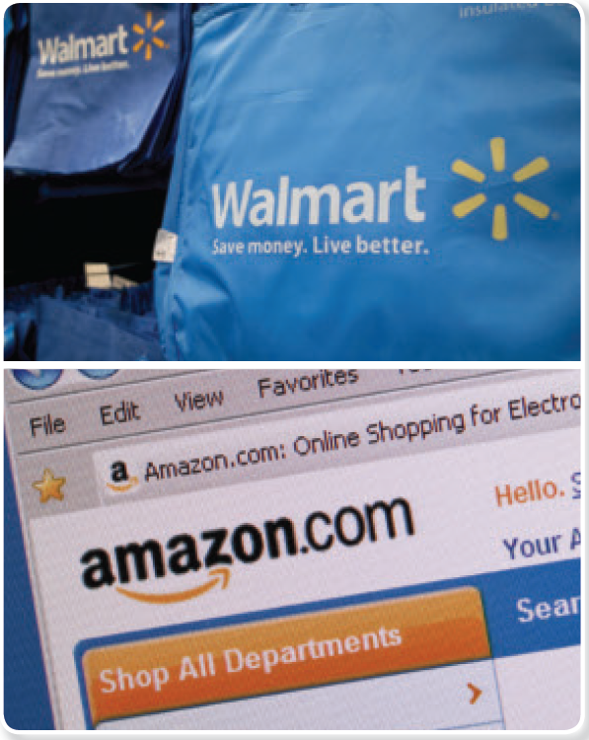
Pricing Strategies
Copyright © 2016 Pearson Education, Inc.
11-2
Notes:
Walmart versus Amazon online: Achieving online supremacy will take more than just waging and winning an online price war. But in the long run, winning the war will take much more than just low prices. The spoils will go to the company that delivers the best overall online customer experience and value for the price.

Slide 3
Pricing Strategies
Learning Objectives
Objective 1: Describe the major strategies for pricing new products.
Objective 2: Explain how companies find a set of prices that maximizes the profits from the total product mix.
Copyright © 2016 Pearson Education, Inc.
11-3
Notes:
Objective 1 Describe the major strategies for pricing new products.
Objective 2 Explain how companies find a set of prices that maximizes the profits from the total product mix.

Slide 4
Pricing Strategies
Learning Objectives
Objective 3: Discuss how companies adjust their prices to take into account different types of customers and situations.
Objective 4: Discuss the key issues related to initiating and responding to price changes.
Objective 5: Overview the social and legal issues that affect pricing decisions.
Copyright © 2016 Pearson Education, Inc.
11-4
Notes:
Objective 3 Discuss how companies adjust their prices to take into account different types of customers and situations.
Objective 4 Discuss the key issues related to initiating and responding to price changes.
Objective 5 Overview the social and legal issues that affect pricing decisions.

Slide 5
Pricing Strategies
Learning Objective 1
Describe the major strategies for pricing new products.
New Product Pricing Strategies
Copyright © 2016 Pearson Education, Inc.
11-5

Slide 6
New Product Pricing Strategies
Market-skimming Pricing
Market-skimming pricing strategy sets high initial prices to “skim” revenue layers from the market.
    Product quality and image must support the price.
    Buyers must want the product at the price.
Copyright © 2016 Pearson Education, Inc.
11-6
Notes:
Pricing strategies usually change as the product passes through its life cycle. The introductory stage is especially challenging. Companies bringing out a new product face the challenge of setting prices for the first time. They can choose between two broad strategies: market-skimming pricing and market-penetration pricing.
Apple frequently uses market-skimming pricing (or price skimming). When Apple first introduced the iPhone, its initial price was as high as $599 per phone. The phones were purchased only by customers who really wanted the sleek new gadget and could afford to pay a high price for it. Six months later, Apple dropped the price to $399 for an 8-GB model and $499 for the 16-GB model to attract new buyers. Within a year, it dropped prices again to $199 and $299, respectively, and you can now get a basic 8-GB model for free with a wireless phone contract. In this way, Apple has skimmed the maximum amount of revenue from the various segments of the market.
Market skimming makes sense only under certain conditions. First, the product’s quality and image must support its higher price, and enough buyers must want the product at that price. Second, the costs of producing a smaller volume cannot be so high that they cancel the advantage of charging more. Finally, competitors should not be able to enter the market easily and undercut the high price.

Slide 7

New Product Pricing Strategies
Market-penetration Pricing
Market-penetration pricing involves setting a low price for a new product in order to attract a large number of buyers and a large market share.
Copyright © 2016 Pearson Education, Inc.
11-7
Notes:
Penetration pricing: Samsung has used low initial prices to make quick and deep inroads into emerging mobile device markets such as Africa and India.
Rather than setting a high initial price to skim off small but profitable market segments, some companies use market-penetration pricing.
The high sales volume results in falling costs, allowing companies to cut their prices even further.

Slide 8
Pricing Strategies
Learning Objective 1
Describe the major strategies for pricing new products.
    Market-skimming pricing
    Market-penetration pricing
Copyright © 2016 Pearson Education, Inc.
11-8
Notes:
Discussion Question
Compare and contrast market-skimming and market-penetration pricing strategies and discuss the conditions under which each is appropriate. For each strategy, give
an example of a recently introduced product that used that pricing strategy.
Learning Objective 1 Summary
Pricing is a dynamic process, and pricing strategies usually change as the product passes through its life cycle. The introductory stage—setting prices for the first time—is especially challenging. The company can decide on one of several strategies for pricing innovative new products. It can use market-skimming pricing by initially setting high prices to “skim” the maximum amount of revenue from various segments of the market. Or it can use market-penetrating pricing by setting a low initial price to penetrate the market deeply and win a large market share. Several conditions must be set for either new product pricing strategy to work.

Slide 9
Pricing Strategies
Learning Objective 2
Explain how companies find a set of prices that maximizes the profits from the total product mix.
Product Mix Pricing Strategies
Copyright © 2016 Pearson Education, Inc.
11-9

Slide 10
Product Mix Pricing Strategies
Product line pricing
Optional product pricing
Captive product pricing
By-product pricing
Product bundle pricing
Copyright © 2016 Pearson Education, Inc.
11-10
Notes:
The strategy for setting a product’s price often has to be changed when the product is part of a product mix. In this case, the firm looks for a set of prices that maximizes its profits on the total product mix. Pricing is difficult because the various products have related demands and costs and face different degrees of competition.

Slide 11
Product Mix Pricing Strategies
Product Line and Optional Product Pricing
Product line pricing takes into account the cost differences between products in the line, customer evaluations of their features, and competitors’ prices.
Optional product pricing takes into account optional or accessory products along with the main product.
Copyright © 2016 Pearson Education, Inc.
11-11
Notes:
Product Line Pricing
Companies usually develop product lines rather than single products. In product line pricing, management must determine the price steps to set between the various products in a line. The product line could include a broad range of prices for the various products.
Optional Product Pricing
Pricing options is a sticky problem. Companies must decide which items to include in the base price and which to offer as options.

Slide 12
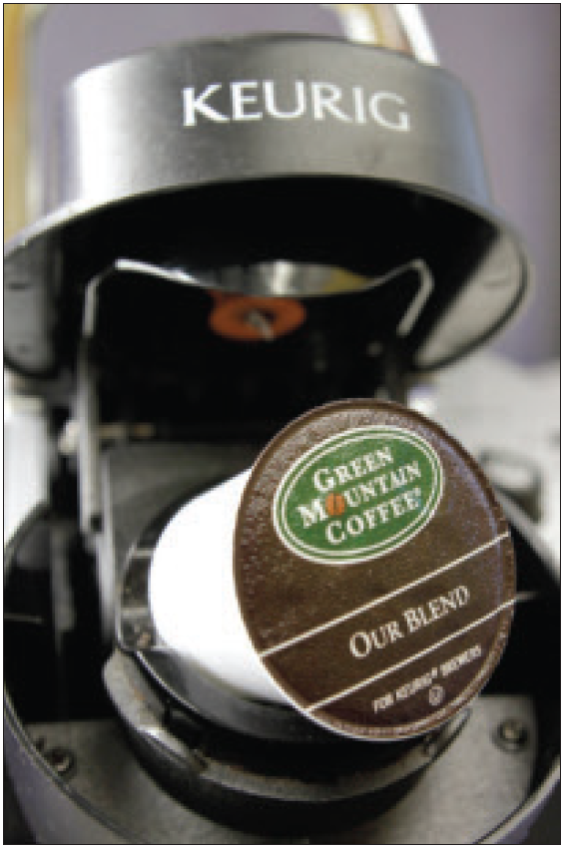
Product Mix Pricing Strategies
Captive Product Pricing
Captive product pricing sets prices of products that must be used along with the main product.
Copyright © 2016 Pearson Education, Inc.
11-12
Notes:
Captive product pricing: Nearly 73 percent of Keurig’s sales come from its K-Cup portion packs. The brand must find the right balance between main-product and captive-product prices.
Examples of captive products are razor blade cartridges, videogames, printer cartridges, and e-books. Producers of the main products often price them low and set high markups on the supplies. For example, Amazon introduced its Kindle Fire tablet for as low as $199, a loss of an estimated $10 per machine. It hoped to more than make up for the loss through sales of digital books, music, and movies to be viewed on the devices.
However, companies that use captive product pricing must be careful. Finding the right balance between the main product and captive product prices can be tricky. Even more, consumers trapped into buying expensive captive products may come to resent the brand that ensnared them.
In the case of services, captive product pricing is called two-part pricing. The price of the service is broken into a fixed fee plus a variable usage rate. Thus, at Six Flags and other amusement parks, you pay a daily ticket or season pass charge plus additional fees for food and other in-park features.

Slide 13
Product Mix Pricing Strategies
By-product and Product Bundle Pricing
By-product pricing sets a price for by-products in order to make the main product’s price more competitive.
Product bundle pricing combines several products at a reduced price.
Copyright © 2016 Pearson Education, Inc.
11-13
Notes:
Producing products and services often generates by-products. If the by-products have no value and if getting rid of them is costly, this will affect pricing of the main product. Using by-product pricing, the company seeks a market for these by-products to help offset the costs of disposing of them and help make the price of the main product more competitive. The by-products themselves can even turn out to be profitable—turning trash into cash.
Using product bundle pricing, sellers often combine several products and offer the bundle at a reduced price. For example, fast-food restaurants bundle a burger, fries, and a soft drink at a “combo” price. And Comcast, Time Warner, Verizon, and other telecommunications companies bundle TV service, phone service, and high-speed Internet connections at a low combined price. Price bundling can promote the sales of products consumers might not otherwise buy, but the combined price must be low enough to get them to buy the bundle.

Slide 14
Pricing Strategies
Learning Objective 2
Explain how companies find a set of prices that maximizes the profits from the total product mix.
    Product line pricing
    Optional product pricing
    Captive product pricing
    By-product pricing
    Product bundle pricing
Copyright © 2016 Pearson Education, Inc.
11-14
Notes:
Discussion Question
Define captive-product pricing and give examples. What must marketers be concerned about when implementing this type of pricing?
Learning Objective 2 Summary
When the product is part of a product mix, the firm searches for a set of prices that will maximize the profits from the total mix. In product line pricing, the company determines the price steps for the entire product line it offers. In addition, the company must set prices for optional products (optional or accessory products included with the main product), captive products (products that are required for using the main product), and by-products (waste or residual products produced when making the main product).

Slide 15
Pricing Strategies
Learning Objective 3
Discuss how companies adjust their prices to take into account different types of customers and situations.
Price Adjustment Strategies
Copyright © 2016 Pearson Education, Inc.
11-15

Slide 16
Price Adjustment Strategies
Discount and allowance pricing
Segmented pricing
Psychological pricing
Promotional pricing
Geographic pricing
Dynamic pricing
International pricing
Copyright © 2016 Pearson Education, Inc.
11-16
Notes:
Companies usually adjust their basic prices to account for various customer differences and changing situations. Here, we examine the seven price adjustment strategies summarized in Table 11.2: discount and allowance pricing, segmented pricing, psychological pricing, promotional pricing, geographical pricing, dynamic pricing, and international pricing.

Slide 17
Price Adjustment Strategies
Discount and Allowance Pricing
Discount and allowance pricing reduces prices to reward customer responses such as making volume purchases, paying early, or promoting the product.
Copyright © 2016 Pearson Education, Inc.
11-17
Notes:
Discounts include cash discounts for paying promptly, quantity discounts for buying in large volume, or functional (trade) discounts for selling, storing, distribution, and record keeping.
Allowances include trade-in allowances for turning in old items when buying new ones and promotional allowances to reward dealers for participating in advertising or sales support programs.

Slide 18

Price Adjustment Strategies
Segmented Pricing
Segmented pricing involves selling a product or service at two or more prices, where the difference in prices is not based on differences in costs.
Copyright © 2016 Pearson Education, Inc.
11-18
Notes:
Product-form pricing: A roomier business class seat on a flight from New York to London is many times the price of an economy seat on the same flight. To customers who can afford it, the extra comfort and service are worth the extra charge.
In segmented pricing companies will often adjust their basic prices to allow for differences in customers, products, and locations.

Slide 19
Price Adjustment Strategies
Segmented Pricing
Customer-segment pricing
Product-form pricing
Location-based pricing
Time-based pricing
Copyright © 2016 Pearson Education, Inc.
11-19
Notes:
Segmented pricing takes several forms.
Under customer-segment pricing, different customers pay different prices for the same product or service. Museums and movie theaters, for example, may charge a lower admission for students and senior citizens.
Under product-form pricing, different versions of the product are priced differently but not according to differences in their costs.
Using location-based pricing, a company charges different prices for different locations, even though the cost of offering each location is the same. For instance, state universities charge higher tuition for out-of-state students, and theaters vary their seat prices because of audience preferences for certain locations.
Finally, using time-based pricing, a firm varies its price by the season, the month, the day, and even the hour. For example, movie theaters charge matinee pricing during the daytime, and resorts give weekend and seasonal discounts.

Slide 20
Price Adjustment Strategies
Segmented Pricing
For segmented pricing to be effective:
  Market must be segmentable
  Segments must show different degrees of demand
  Costs of segmenting cannot exceed the extra revenue
  Must be legal
Copyright © 2016 Pearson Education, Inc.
11-20
Notes:
Discussion Question
How have you benefited from price segmentation?
Most likely they have had student discounts. Ask them why that is effective given the criteria above.
It is most important that segmented prices reflect real differences in customers’ perceived value. Consumers in higher price tiers must feel that they’re getting their extra money’s worth for the higher prices paid. By the same token, companies must be careful not to treat customers in lower price tiers as second-class citizens. Otherwise, in the long run, the practice will lead to customer resentment and ill will.
For example, in recent years, the airlines have incurred the wrath of frustrated customers at both ends of the airplane. Passengers paying full fare for business- or first-class seats often feel that they are being gouged. At the same time, passengers in lower-priced coach seats feel that they’re being ignored or treated poorly.

Slide 21
Price Adjustment Strategies
Psychological Pricing
Psychological pricing considers the psychology of prices and not simply the economics; the price is used to say something about the product.
Reference prices are prices that buyers carry in their minds and refer to when they look at a given product.
Copyright © 2016 Pearson Education, Inc.
11-21
Notes:
Discussion Question
How well do you carry prices of coffee, pizza, and milk in your head?
It might be interesting to collect the prices of items sold near or on campus including coffee, pizza, and sandwiches. Ask students how well they know these prices, have them write down the price of these items, and then check themselves. You will often find that people do NOT know prices as well as they think they do.
With psychological pricing, consumers usually perceive higher-priced products as having higher quality. Who’s the better lawyer, one who charges $50 per hour or one who charges $500 per hour?
Another aspect of psychological pricing is reference prices which might be formed by noting current prices, remembering past prices, or assessing the buying situation. Sellers can influence or use these consumers’ reference prices when setting price. For example a grocery retailer might place its store brand next to a more expensive branded item or offer more expensive models that don’t sell very well to make its less expensive but still high-priced models look more affordable by comparison.
Even small differences in price can signal product differences. A 9 or 0.99 at the end of a price often signals a bargain. High-end retailers might favor prices ending in a whole number and others use 00-cent endings on regularly priced items and 99-cent endings on discount merchandise.

Slide 22
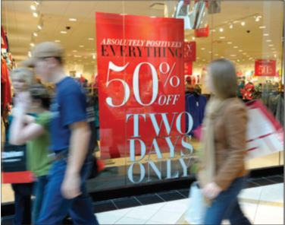
Price Adjustment Strategies
Promotional Pricing
Promotional pricing is temporarily pricing products below the list price, and sometimes even below cost, to increase short-run sales.
Copyright © 2016 Pearson Education, Inc.
11-22
Notes:
Promotional pricing: T-Mobile’s “Break Free from WiFi” price promotion provides powerful buying and switching incentives, including discounts on T-Mobile 4G LTE tablets and a free data plan.
Promotional pricing, takes several forms.
Discounts from normal prices to increase sales and reduce inventories
Special-event pricing in certain seasons to draw more customers
Limited-time offers, such as online flash sales, to make buyers feel they have gotten a deal
Cash rebates to consumers who buy the product from dealers within a specified time
Low-interest financing, longer warranties, or free maintenance to reduce the consumer’s “price”
Promotional pricing, however, can have adverse effects. During most holiday seasons, for example, it’s an all-out bargain war. Marketers carpet-bomb consumers with deals, causing buyer wear-out and pricing confusion. Used too frequently, price promotions can create “deal-prone” customers who wait until brands go on sale before buying them. In addition, constantly reduced prices can erode a brand’s value in the eyes of customers.
Marketers sometimes become addicted to promotional pricing, especially in tight economic times. They use price promotions as a quick fix instead of sweating through the difficult process of developing effective longer-term strategies for building their brands. Companies must be careful to balance short-term sales incentives against long-term brand building.

Slide 23
Price Adjustment Strategies
Geographical Pricing
Geographical pricing is used for customers in different parts of the country or the world.
    FOB-origin pricing
    Uniform-delivered pricing
    Zone pricing
    Basing-point pricing
    Freight-absorption pricing
Copyright © 2016 Pearson Education, Inc.
11-23
Notes:
Geographical Pricing
A company also must decide how to price its products for customers located in different parts of the United States or the world. Should the company risk losing the business of more-distant customers by charging them higher prices to cover the higher shipping costs?

Slide 24
Price Adjustment Strategies
Geographical Pricing
FOB-origin (free on board) pricing is a geographical pricing strategy in which goods are placed free on board a carrier; the customer pays the freight from the factory to the destination.
Uniform-delivered pricing is a geographical pricing strategy in which the company charges the same price plus freight to all customers, regardless of their location.
Copyright © 2016 Pearson Education, Inc.
11-24
Notes:
Since a customer picks up its own cost, supporters of FOB-origin pricing feel that this is the fairest way to assess freight charges. The disadvantage, however, is that the company will be a high-cost firm to distant customers.
Uniform-delivered pricing is the opposite of FOB pricing. Here, the company charges the same price plus freight to all customers, regardless of their location. The freight charge is set at the average freight cost.

Slide 25
Price Adjustment Strategies
Geographical Pricing
Zone pricing is a strategy in which the company sets up two or more zones where customers within a given zone pay the same price.
Basing-point pricing means that a seller selects a given city as a “basing point” and charges all customers the freight cost from that city to the customer.
Copyright © 2016 Pearson Education, Inc.
11-25
Notes:
Zone pricing falls between FOB-origin pricing and uniform-delivered pricing. The more distant the zone, the higher the price. In this way, the customers within a given price zone receive no price advantage from the company. For example, customers in Atlanta and Boston may pay the same total price even if the actual freight cost for Atlanta is significant less than Boston. One complaint about this strategy is that the Atlanta customer is paying part of the Boston customer’s freight cost.
Using basing-point pricing, a company may set Chicago as the basing point and charge all customers the freight cost from Chicago to the customer’s location. This means that an Atlanta customer pays the freight cost from Chicago to Atlanta, even though the goods may be shipped from Atlanta. If all sellers used the same basing-point city, delivered prices would be the same for all customers, and price competition would be eliminated.

Slide 26
Price Adjustment Strategies
Geographical Pricing
Freight-absorption pricing is a strategy in which the seller absorbs all or part of the freight charges in order to get the desired business.
Copyright © 2016 Pearson Education, Inc.
11-26
Notes:
The seller who is anxious to do business with a certain customer or geographical area might use freight-absorption pricing. The seller might reason that if it can get more business, its average costs will decrease and more than compensate for its extra freight cost. Freight-absorption pricing is used for market penetration and to hold on to increasingly competitive markets.

Slide 27
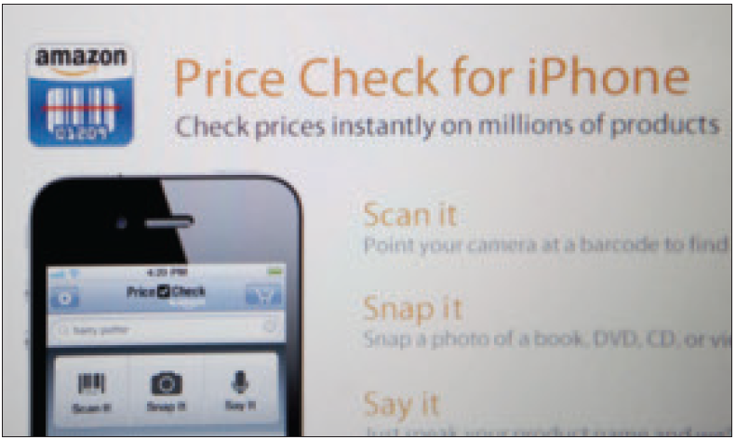
Price Adjustment Strategies
Dynamic and Internet Pricing
Dynamic pricing involves adjusting prices continually to meet the characteristics and needs of individual customers and situations.
Copyright © 2016 Pearson Education, Inc.
11-27
Notes:
Dynamic pricing: Kohl’s and many other retailers are now using digital price tags that allow them to quickly adjust prices on individual items based on competitive and other market requirements.
Today, most companies use fixed price policies—setting one price for all buyers. However, some companies are now reversing the fixed pricing trend and are now using dynamic pricing.
Dynamic pricing is especially prevalent online. Services ranging from airlines and hotels to sports teams change prices on the fly according to changes in demand or costs, adjusting what they charge for specific items on a day-by-day or even hour-by-hour basis
Also thanks to the Internet, consumers can get instant product and price comparisons from thousands of vendors at price comparison sites and armed with this information, consumers can often negotiate better in-store prices.
In fact, many retailers are finding that ready online access to comparison prices is giving consumers too much of an edge. Store retailers are now devising dynamic pricing strategies to combat the consumer practice of showrooming, comparing prices online while in the store, and then buying the item online at a lower price.

Slide 28
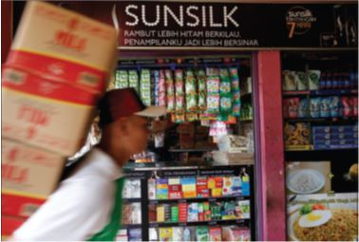
Price Adjustment Strategies
International Pricing
International pricing sets prices in a specific country based on many factors.
  Economic conditions
  Competitive situations
  Laws and regulations
  Wholesaling and retail systems
Copyright © 2016 Pearson Education, Inc.
11-28
Notes:
International pricing: To lower prices in emerging markets, such as Indonesia shown here, Unilever developed smaller, single-use packets of its Sunsilk, Ponds, Dove, and other brands that sell at prices even the world’s poorest consumers can afford.
Companies that market their products internationally must decide what prices to charge in different countries. In some cases, a company can set a uniform worldwide price. For example, Boeing sells its jetliners at about the same price everywhere. However, most companies adjust their prices to reflect local market conditions and cost considerations.
Consumer perceptions and preferences also may vary from country to country, calling for different prices. Or the company may have different marketing objectives in various world markets, which require changes in pricing strategy.
For example, Apple introduces sophisticated, feature-rich, premium smartphones in carefully segmented mature markets in highly developed countries using a market-skimming pricing strategy. By contrast, it’s now under pressure to discount older models and develop a more basic phone for sizable but less affluent markets in developing countries, supported by penetration pricing.
Price escalation resulting from differences in selling strategies, market conditions, or simply a result of the higher costs of selling in another country plays an important role in setting international prices.
Price has become a key element in the international marketing strategies of companies attempting to enter less affluent emerging markets. Typically, entering such markets has meant targeting the exploding middle classes in developing countries. More recently, however, as the weakened global economy has slowed growth in both domestic and emerging markets, many companies are shifting their sights to include a new target—the so-called “bottom of the pyramid,” the vast untapped market consisting of the world’s poorest consumers.

Slide 29
Pricing Strategies
Learning Objective 3
Discuss how companies adjust their prices to take into account different types of customers and situations.
    Discount and allowance pricing
    Segmented pricing
    Psychological pricing
    Promotional pricing
    Geographical pricing
    Dynamic and Internet pricing
    International pricing
Copyright © 2016 Pearson Education, Inc.
11-29
Notes:
Discussion Questions
What is dynamic pricing? Why is it especially prevalent online? Is it legal?
Learning Objective 3 Summary
Companies apply a variety of price adjustment strategies to account for differences in consumer segments and situations. One is discount and allowance pricing, whereby the company establishes cash, quantity, functional, or seasonal discounts, or varying types of allowances. A second strategy is segmented pricing, where the company sells a product at two or more prices to accommodate different customers, product forms, locations, or times. Sometimes companies consider more than economics in their pricing decisions, using psychological pricing to better communicate a product’s intended position. In promotional pricing, a company offers discounts or temporarily sells a product below list price as a special event, sometimes even selling below cost as a loss leader. Another approach is geographical pricing, whereby the company decides how to price to distant customers, choosing from such alternatives as FOB-origin pricing, uniform-delivered pricing, zone pricing, basing-point pricing, and freight-absorption pricing. Using dynamic pricing, a company can adjust prices continually to meet the characteristics and needs of individual customers and situations. Finally, international pricing means that the company adjusts its price to meet different conditions and expectations in different world markets.

Slide 30
Pricing Strategies
Learning Objective 4
Discuss the key issues related to initiating and responding to price changes.
Price Changes
Copyright © 2016 Pearson Education, Inc.
11-30

Slide 31
Price Changes
Initiating Pricing Changes
Price cuts occur due to:
Excess capacity
Price increases occur due to:
Cost inflation
Increased market share
Increased demand
Lack of supply
Copyright © 2016 Pearson Education, Inc.
11-31
Notes:
Initiating Price Cuts
Several situations may lead a firm to consider cutting prices. One such circumstance is excess capacity. Another is falling demand in the face of strong price competition or a weakened economy. In such cases, the firm may aggressively cut prices to boost sales and market share. Cutting prices in an industry loaded with excess capacity may lead to price wars as competitors try to hold on to market share.
A company may also cut prices in a drive to dominate the market through lower costs. Either the company starts with lower costs than its competitors, or it cuts prices in the hope of gaining market share that will further cut costs through larger volume. For example, computer and electronics maker Lenovo uses an aggressive low-cost, low-price strategy to increase its share of the PC market in developing countries.
Initiating Price Increases
A successful price increase can greatly improve profits. For example, if the company’s profit margin is 3 percent of sales, a 1 percent price increase will boost profits by 33 percent if sales volume is unaffected. When a company cannot supply all that its customers need, it may raise its prices, ration products to customers, or both—consider today’s worldwide oil and gas industry.
When raising prices, the company must avoid being perceived as a price gouger. Customers have long memories, and they will eventually turn away from companies or even whole industries that they perceive as charging excessive prices. In the extreme, claims of price gouging may even bring about increased government regulation.
There are some techniques for avoiding these problems. One is to maintain a sense of fairness surrounding any price increase. Price increases should be supported by company communications telling customers why prices are being raised.
Wherever possible, the company should consider ways to meet higher costs or demand without raising prices, such as by:
using more cost-effective ways to produce or distribute its products.
“unbundling” its market offering and price elements separately.
shrinking the product or substituting less-expensive ingredients.

Slide 32
Price Changes
Buyer Reactions to Pricing Changes
Price increases
Product is “hot”
Company greed
Price cuts
New models will be available
Models are not selling well
Quality issues
Copyright © 2016 Pearson Education, Inc.
11-32
Notes:
Customers do not always interpret price changes in a straightforward way. A price increase may have positive meanings for some buyers while others may think the company is simply being greedy by charging what the traffic will bear.
Similarly, consumers may view a price cut as getting a better deal on an exclusive product. Or price cuts may be associated with reductions in quality or the brand’s image being tarnished.

Slide 33
Price Changes
Competitor Reactions to Pricing Changes
  Why did the competitor change the price?
  Is the price cut permanent or temporary?
  Is the company trying to grab market share?
  Is the company doing poorly and trying to increase sales?
  Is it a signal to decrease industry prices to stimulate demand?
Copyright © 2016 Pearson Education, Inc.
11-33
Notes:
A firm considering a price change must worry about the reactions of its competitors as well as those of its customers. Competitors are most likely to react when the number of firms involved is small, when the product is uniform, and when the buyers are well informed about products and prices. How can the firm anticipate the likely reactions of its competitors?
The problem is complex because, like the customer, the competitor can interpret a company price cut in many ways. The company must guess each competitor’s likely reaction. Figure 11.1 on the next slide explores this issue further.

Slide 34
Price Changes
Responding to Price Changes
Copyright © 2016 Pearson Education, Inc.
11-34
Notes:
Figure 11.1 shows the ways a company might assess and respond to a competitor’s price cut. Suppose the company learns that a competitor has cut its price and decides that this price cut is likely to harm its sales and profits. It might simply decide to hold its current price and profit margin. The company might believe that it will not lose too much market share, or that it would lose too much profit if it reduced its own price. Or it might decide that it should wait and respond when it has more information on the effects of the competitor’s price change. However, waiting too long to act might let the competitor get stronger and more confident as its sales increase.

Slide 35
Price Changes
Responding to Price Changes
Effective Action Responses
  Reduce price to match competition
  Maintain price but raise the perceived value through communications
  Improve quality and increase price
  Launch a lower-price “fighting” brand
Copyright © 2016 Pearson Education, Inc.
11-35
Notes:
If the company decides that effective action can and should be taken, it might make any of four responses shown on this slide.

Slide 36
Pricing Strategies
Learning Objective 4
Discuss the key issues related to initiating and responding to price changes.
    Initiating Price Changes
    Buyer Reactions to Price Changes
    Competitor Reactions to Price Changes
    Responding to Price Changes
Copyright © 2016 Pearson Education, Inc.
11-36
Notes:
Discussion Question
Should a company always respond to a competitor’s price cut, and what options are available if it does decide to respond?
Learning Objective 4 Summary
When a firm considers initiating a price change, it must consider customers’ and competitors’ reactions. There are different implications to initiating price cuts and initiating price increases. Buyer reactions to price changes are influenced by the meaning customers see in the price change. Competitors’ reactions flow from a set reaction policy or a fresh analysis of each situation.
There are also many factors to consider in responding to a competitor’s price changes. The company that faces a price change initiated by a competitor must try to understand the competitor’s intent as well as the likely duration and impact of the change. If a swift reaction is desirable, the firm should preplan its reactions to different possible price actions by competitors. When facing a competitor’s price change, the company might sit tight, reduce its own price, raise perceived quality, improve quality and raise price, or launch a fighter brand.

Slide 37
Pricing Strategies
Learning Objective 5
Overview the social and legal issues that affect pricing decisions.
Public Policy and Pricing
Copyright © 2016 Pearson Education, Inc.
11-37

Slide 38
Public Policy and Pricing
Copyright © 2016 Pearson Education, Inc.
11-38
Notes:
Figure 11.2 shows the major public policy issues in pricing. These include potentially damaging pricing practices within a given level of the channel (price-fixing and predatory pricing) and across levels of the channel (retail price maintenance, discriminatory pricing, and deceptive pricing).

Slide 39
Public Policy and Pricing
Pricing Within Channel Levels
Price fixing legislation requires sellers to set prices without talking to competitors.
Predatory pricing legislation prohibits selling below cost with the intention of punishing a competitor or gaining higher long-term profits by putting competitors out of business.
Copyright © 2016 Pearson Education, Inc.
11-39
Notes:
Price competition is a core element of our free-market economy. In setting prices, companies usually are not free to charge whatever prices they wish. Many federal, state, and even local laws govern the rules of fair play in pricing. In addition, companies must consider broader societal pricing concerns. In setting their prices, for example, pharmaceutical firms must balance their development costs and profit objectives against the sometimes life-and-death needs of drug consumers.
The most important pieces of legislation affecting pricing are the Sherman Act, the Clayton Act, and the Robinson-Patman Act, initially adopted to curb the formation of monopolies and regulate business practices that might unfairly restrain trade.
Price-fixing is illegal per se—that is, the government does not accept any excuses for price-fixing. As such, companies found guilty of these practices can receive heavy fines. Recently, governments at the state and national levels have been aggressively enforcing price-fixing regulations in industries ranging from gasoline, insurance, and concrete to credit cards, CDs, and computer chips. Price-fixing is also prohibited in many international markets.
For example, European Union regulators recently fined consumer products giants Unilever and P&G a combined $456 million for fixing laundry detergent prices in eight EU countries. France also fined the two consumer products giants, along with competitors Colgate and Henkel. It claimed that officials from the four companies met regularly at hotels and restaurants in Paris to agree to limits on the size of discounts and on price differences between their laundry detergent brands.
Sellers are also prohibited from using predatory pricing—selling below cost with the intention of punishing a competitor or gaining higher long-run profits by putting competitors out of business. This protects small sellers from larger ones who might sell items below cost temporarily or in a specific locale to drive them out of business.
The biggest problem is determining just what constitutes predatory pricing behavior. Selling below cost to unload excess inventory is not considered predatory; selling below cost to drive out competitors is. Thus, a given action may or may not be predatory depending on intent, and intent can be very difficult to determine or prove.

Slide 40
Public Policy and Pricing
Pricing Across Channel Levels
Robinson-Patman Act prevents unfair price discrimination by ensuring that the seller offer the same price terms to customers at a given level of trade.
Price discrimination is allowed if the seller:
  can prove that costs differ when selling to different retailers
  manufactures different qualities of the same product for different retailers
Copyright © 2016 Pearson Education, Inc.
11-40
Notes:
Every retailer is entitled to the same price terms from a given manufacturer. Price differentials may also be used to “match competition” in “good faith,” provided the price discrimination is temporary, localized, and defensive rather than offensive.

Slide 41
Public Policy and Pricing
Pricing Across Channel Levels
Retail (or resale) price maintenance is when a manufacturer requires a dealer to charge a specific retail price for its product, which is prohibited by law.
Copyright © 2016 Pearson Education, Inc.
11-41
Notes:
Although the seller can propose a manufacturer’s suggested retail price to dealers, it cannot refuse to sell to a dealer that takes independent pricing action, nor can it punish the dealer by shipping late or denying advertising allowances.
For example, the Florida attorney general’s office investigated Nike for allegedly fixing the retail price of its shoes and clothing. It was concerned that Nike might be withholding items from retailers who were not selling its most expensive shoes at prices the company considered suitable.

Slide 42
Public Policy and Pricing
Pricing Across Channel Levels
Deceptive pricing occurs when a seller states prices or price savings that mislead consumers or are not actually available to consumers.
    Bogus reference or comparison prices
    Scanner fraud and price confusion
Copyright © 2016 Pearson Education, Inc.
11-42
Notes:
Many federal and state statutes regulate against deceptive pricing practices. For example, the Automobile Information Disclosure Act requires automakers to attach a statement on new vehicle windows stating the manufacturer’s suggested retail price, the prices of optional equipment, and the dealer’s transportation charges. However, reputable sellers go beyond what is required by law. Treating customers fairly and making certain that they fully understand prices and pricing terms is an important part of building strong and lasting customer relationships.

Slide 43
Pricing Strategies
Learning Objective 5
Overview the social and legal issues that affect pricing decisions.
    Pricing Within Channel Levels
    Pricing Across Channel Levels
Copyright © 2016 Pearson Education, Inc.
11-43
Notes:
Discussion Question
Briefly discuss the major policy issues across levels of the channel of distribution.
Learning Objective 5 Summary
Many federal, state, and even local laws govern the rules of fair pricing. Also, companies must consider broader societal pricing concerns. The major public policy issues in pricing include potentially damaging pricing practices within a given level of the channel, such as price-fixing and predatory pricing. They also include pricing practices across channel levels, such as retail price maintenance, discriminatory pricing, and deceptive pricing. Although many federal and state statutes regulate pricing practices, reputable sellers go beyond what is required by law. Treating customers fairly is an important part of building strong and lasting customer relationships.

Slide 44
Principles of Marketing
PowerPoint Copyright Page
Copyright © 2016 Pearson Education, Inc.
11-44

