Slide 1
Principles of Marketing
Kotler and Armstrong
Insert
Textbook
Cover Image
Chapter 7:
Customer-Driven Marketing Strategy
Creating Value for Target Customers
7-1

Slide 2
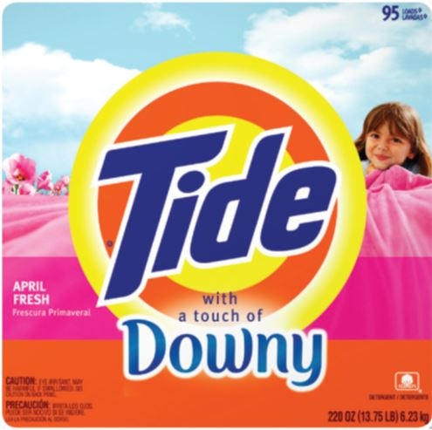
Customer-Driven Marketing Strategy
7-2
Notes:
P&G’s many brands often compete head to head on crowded supermarket shelves. But thanks to smart segmentation and positioning, when P&G competes against itself—it wins.
By offering brands and sub-brands that target specific segments of detergent preferences (here Ultra Tide Plus a Touch of Downy), Tide offers a unique value proposition to each distinct segment of customers.

Slide 3
Customer-Driven Marketing Strategy
Learning Objectives
Objective 1: Define the major steps in designing a customer-driven marketing strategy: market segmentation, targeting, differentiation, and positioning.
Objective 2: List and discuss the major bases for segmenting consumer and business markets.
Copyright © 2016 Pearson Education, Inc.
7-3
Notes:
Objective 1 Define the major steps in designing a customer-driven marketing strategy: market segmentation, targeting, differentiation, and positioning.
Objective 2 List and discuss the major bases for segmenting consumer and business markets.

Slide 4
Customer-Driven Marketing Strategy
Learning Objectives
Objective 3: Explain how companies identify attractive market segments and choose a market-targeting strategy.
Objective 4: Discuss how companies differentiate and position their products for maximum competitive advantage.
Copyright © 2016 Pearson Education, Inc.
7-4
Notes:
Objective 3 Explain how companies identify attractive market segments and choose a market-targeting strategy.
Objective 4 Discuss how companies differentiate and position their products for maximum competitive advantage.

Slide 5
Customer-Driven Marketing Strategy
Learning Objective 1
Define the major steps in designing a customer-driven marketing strategy: market segmentation, targeting, differentiation, and positioning.
Customer-Driven Marketing Strategy
Copyright © 2016 Pearson Education, Inc.
7-5

Slide 6
Customer-Driven Marketing Strategy
FIGURE | 7.1
Designing a Customer-Driven Market Strategy
Copyright © 2016 Pearson Education, Inc.
7-6
Notes:
Companies today recognize that they cannot appeal to all buyers in the marketplace—or at least not to all buyers in the same way. They must design customer-driven marketing strategies that build the right relationships with the right customers.
Thus, most companies have moved away from mass marketing and toward target marketing: identifying market segments, selecting one or more of them, and developing products and marketing programs tailored to each.
Figure 7.1 shows the four major steps in designing a customer-driven marketing strategy:
Segmentation
Targeting
Differentiation
Positioning
We will discuss each of these steps in turn.

Slide 7
Customer-Driven Marketing Strategy
Learning Objective 1
Define the major steps in designing a customer-driven marketing strategy: market segmentation, targeting, differentiation, and positioning.
Customer-Driven Marketing Strategy
Copyright © 2016 Pearson Education, Inc.
7-7
Notes:
Discussion Question
What are the four major steps in designing a customer-driven marketing strategy?
Learning Objective 1 Summary
A customer-driven marketing strategy begins with selecting which customers to serve and determining a value proposition that best serves the targeted customers. It consists of four steps. Market segmentation is the act of dividing a market into distinct segments of buyers with different needs, characteristics, or behaviors who might require separate products or marketing mixes. Once the groups have been identified, market targeting evaluates each market segment’s attractiveness and selects one or more segments to serve. Differentiation involves actually differentiating the market offering to create superior customer value. Positioning consists of positioning the market offering in the minds of target customers. A customer-driven marketing strategy seeks to build the right relationships with the right customers.

Slide 8
Customer-Driven Marketing Strategy
Learning Objective 2
List and discuss the major bases for segmenting consumer and business markets.
Market Segmentation
Copyright © 2016 Pearson Education, Inc.
7-8

Slide 9
Market Segmentation
Market segmentation requires dividing a market into smaller segments with distinct needs, characteristics, or behaviors that might require separate marketing strategies or mixes.
7-9
Notes:
Buyers in any market differ in their wants, resources, locations, buying attitudes, and buying practices. Through market segmentation, companies divide large, heterogeneous markets into smaller segments that can be reached more efficiently and effectively with products and services that match their unique needs.

Slide 10
Market Segmentation
Segmenting consumer markets
Segmenting business markets
Segmenting international markets
Requirements for effective segmentation
7-10
Notes:
In Learning Objective 2, we will discuss four important segmentation topics: segmenting consumer markets, segmenting business markets, segmenting international markets, and the requirements for effective segmentation.

Slide 11
Market Segmentation
Segmenting Consumer Markets
Geographic segmentation
Demographic segmentation
Psychographic segmentation
Behavioral segmentation
Copyright © 2016 Pearson Education, Inc.
7-11
Notes:
There is no single way to segment a market. A marketer has to try different segmentation variables, alone and in combination, to find the best way to view market structure. This visual outlines variables shown in Table 7.1 that might be used in segmenting consumer markets.

Slide 12
Market Segmentation
Segmenting Consumer Markets
Geographic segmentation divides the market into different geographical units such as nations, regions, states, counties, cities, or even neighborhoods.
Copyright © 2016 Pearson Education, Inc.
7-12
Notes:
A company may decide to operate in one or a few geographical areas or operate in all areas but pay attention to geographical differences in needs and wants.
Many companies today are localizing their products, advertising, promotion, and sales efforts to fit the needs of individual regions, cities, and neighborhoods.
For example, Domino’s Pizza, the nation’s largest pizza delivery chain, keeps its marketing and customer focus decidedly local. Customers anywhere in the nation can use the online platform or smartphone app to track down local coupon offers, locate the nearest store with a GPS store locator, and quickly receive a freshly-made pizza. They can even use Domino’s Pizza Tracker to follow their pies locally from store to door.

Slide 13
Market Segmentation
Segmenting Consumer Markets
Demographic segmentation divides the market into segments based on variables such as age, life-cycle stage, gender, income, occupation, education, religion, ethnicity, and generation.
Copyright © 2016 Pearson Education, Inc.
7-13
Notes:
Demographic factors are the most popular bases for segmenting customer groups. One reason is that consumer needs, wants, and usage rates often vary closely with demographic variables. Demographic variables are easier to measure than most other types of variables.
Even when marketers first define segments using other bases, such as benefits sought or behavior, they must know a segment’s demographic characteristics to assess the size of the target market and reach it efficiently.

Slide 14
Market Segmentation
Segmenting Consumer Markets
Age and life-cycle stage segmentation divides a market into different age and life-cycle groups.
Gender segmentation divides a market into different segments based on gender.
Income segmentation divides a market into different income segments.
Copyright © 2016 Pearson Education, Inc.
7-14
Notes:
Consumer needs and wants change with age. Some companies offer different products or use different marketing approaches for different age and life-cycle groups. Other companies offer brands that target specific age or life-stage groups. For example, Amazon targeted a younger tablet market for using the Kindle Fire tablet, introducing FreeTime Unlimited, a multimedia subscription service targeted toward 3- to 8-year-olds. Marketers must be careful to guard against stereotypes when using age and life-cycle segmentation.
Gender segmentation has long been used in clothing, cosmetics, toiletries, and magazines. For example, P&G was among the first to use gender segmentation with Secret, a brand specially formulated for a woman’s chemistry, and packaged and advertised to reinforce the female image. More recently, the men’s personal care industry has exploded, and many cosmetics brands that previously catered mostly to women—like L’Oréal and Nivea—now successfully market men’s lines.
The marketers of products and services such as automobiles, clothing, cosmetics, financial services, and travel have long used income segmentation. Many companies target affluent consumers with luxury goods and convenience services. Other marketers use high-touch marketing programs to court the well-to-do.
Not all companies that use income segmentation target the affluent. For example, many retailers—such as the Dollar General, Family Dollar, and Dollar Tree store chains—successfully target low- and middle-income groups. The core market for such stores is represented by families with incomes under $30,000.

Slide 15
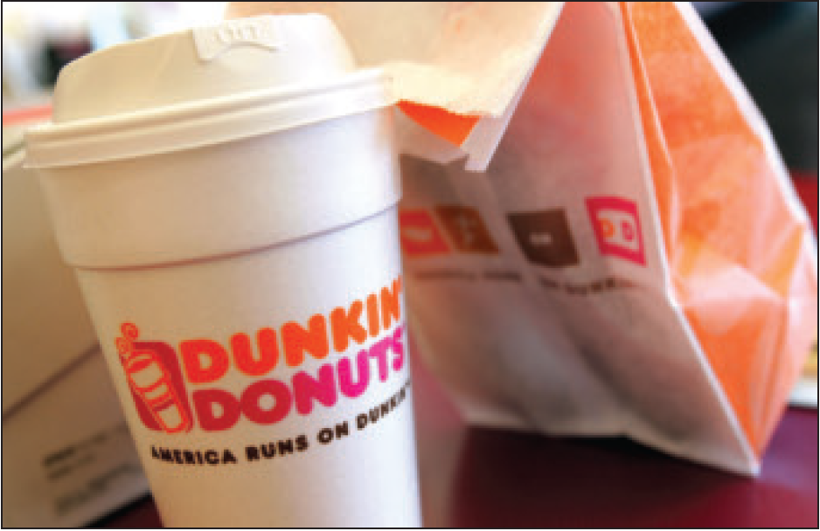
Market Segmentation
Segmenting Consumer Markets
Psychographic segmentation divides a market into different segments based on social class, lifestyle, or personality characteristics.
DUNKIN
Pic
Copyright © 2016 Pearson Education, Inc.
7-15
Notes:
Psychographic segmentation: Dunkin’ Donuts successfully targets the “Dunkin’ tribe”—not the Starbucks coffee snob but the average Joe. Dunkin’ Donuts isn’t like Starbucks—it doesn’t want to be.”
People in the same demographic group can have very different psychographic characteristics.
In Chapter 5, we discussed how the products people buy reflect their lifestyles. Marketers also use personality variables to segment markets. For example, different soft drinks target different personalities. Mountain Dew projects a youthful, rebellious, adventurous personality whereas Coca-Cola Zero appeals to target personality types which are more mature, practical, and cerebral but good-humored. Its subtly humorous ads promise “Real Coca-Cola taste and zero calories.”

Slide 16
Market Segmentation
Segmenting Consumer Markets
Behavioral segmentation divides a market into segments based on consumer knowledge, attitudes, uses of a product, or responses to a product.
Copyright © 2016 Pearson Education, Inc.
7-16
Notes:
Many marketers believe that behavior variables are the best starting point for building market segments.

Slide 17

Market Segmentation
Segmenting Consumer Markets
Behavioral Segmentation
Occasions
Benefits sought
User status
Usage rate
Loyalty status
Copyright © 2016 Pearson Education, Inc.
7-17
Notes:
Benefit segmentation: Schwinn makes bikes for every benefit segment. For example, Schwinn’s urban bikes are “for riders who want a functional, durable, and stylish bike to commute or ride casually in urban areas.”
Occasions refer to when consumers get the idea to buy, actually make their purchase, or use the purchased item. Occasion segmentation can help firms build up product usage. Campbell’s advertises its soups more heavily in the cold winter months, and Home Depot runs special springtime promotions for lawn and gardens products. Other marketers prepare special offers and ads for holiday occasions or nontraditional occasions.
Benefits sought refers to finding the major benefits people look for in a product class, the kinds of people who look for each benefit, and the major brands that deliver each benefit.
Markets can be segmented by user status: nonusers, ex-users, potential users, first-time users, and regular users of a product. Marketers want to reinforce and retain regular users, attract targeted nonusers, and reinvigorate relationships with ex-users.
Markets can also be segmented by usage rate: light, medium, and heavy product users. Heavy users are often a small percentage of the market but account for a high percentage of total consumption. For instance, a recent study showed that heavy seafood consumers in the United States are a small but hungry bunch. Less than 5 percent of all shoppers buy nearly 64 percent of unbreaded seafood consumed in the United States.
Consumers can be loyal to brands, and buyers can be divided into groups according to their degree of loyalty. Some consumers are completely loyal—they buy one brand all the time and can’t wait to tell others about it. Other consumers are somewhat loyal—they are loyal to two or three brands of a given product or favor one brand while sometimes buying others. Still other buyers show no loyalty to any brand—they either want something different each time they buy, or they buy whatever’s on sale. A company can learn a lot by analyzing loyalty patterns in its market, starting with its own loyal customers.

Slide 18
Market Segmentation
Segmenting Consumer Markets
Using Multiple Segmentation Bases
Multiple segmentation is used to identify smaller, better-defined target groups.
Experian’s Mosaic USA system classifies U.S. households into one of 71 lifestyle segments and 19 levels of affluence.
Copyright © 2016 Pearson Education, Inc.
7-18
Notes:
Marketers rarely limit their segmentation analysis to only one or a few variables. Rather, they often use multiple segmentation bases in an effort to identify smaller, better defined target groups. Several business information services like Experian provide multivariable segmentation systems that merge geographic, demographic, lifestyle, and behavioral data to help companies segment their markets down to zip codes, neighborhoods, and even households.
One of the leading consumer segmentation systems is Experian’s Mosaic USA system. Mosaic USA segments carry exotic names such as Birkenstocks and Beemers, Bohemian Groove, Sports Utility Families, Colleges and Cafes, Hispanic Harmony, Rolling the Dice, Small Town Shallow Pockets, and True Grit Americans. Such colorful names help bring the segments to life.
Mosaic USA can help marketers to segment people and locations into marketable groups of like-minded consumers. Each segment has its own pattern of likes, dislikes, lifestyles, and purchase behaviors.
Such rich segmentation provides a powerful tool for marketers of all kinds. It can help companies identify and better understand key customer segments, reach them more efficiently, and tailor market offerings and messages to their specific needs.

Slide 19
Market Segmentation
Segmenting Business Markets
Consumer and business marketers use many of the same variables to segment their markets.
Additional variables include:
Customer operating characteristics
Purchasing approaches
Situational factors
Personal characteristics
Copyright © 2016 Pearson Education, Inc.
7-19
Notes:
Consumer and business marketers can be segmented geographically, demographically (industry, company size), or by benefits sought, user status, usage rate, and loyalty status. Yet, business marketers also use some additional variables.
Almost every company serves at least some business markets. For example, Starbucks has developed distinct marketing programs for each of its two business segments: the office coffee and food service segments.
Many companies establish separate systems for dealing with larger or multiple-location customers. For example, Steelcase, a major producer of office furniture, first divides customers into seven segments, and salespeople work with independent Steelcase dealers to handle smaller, local, or regional Steelcase customers in each segment.
Many national, multiple-location customers, such as ExxonMobil or IBM, have special needs that may reach beyond the scope of individual dealers. Therefore, Steelcase uses national account managers to help its dealer networks handle national accounts.

Slide 20
Market Segmentation
Segmenting International Markets
Geographic location
Economic factors
Political and legal factors
Cultural factors
Copyright © 2016 Pearson Education, Inc.
7-20
Notes:
Few companies have either the resources or the will to operate in all, or even most, of the countries that dot the globe. Operating in many countries presents new challenges. Different countries, even those that are close together, can vary greatly in their economic, cultural, and political makeup. International firms need to group their world markets into segments with distinct buying needs and behaviors. Companies can segment international markets using one or a combination of several variables:
Geographic location involves grouping countries by regions such as Western Europe, the Pacific Rim, the Middle East, or Africa. Geographic segmentation assumes that nations close to one another will have many common traits and behaviors, however there are many exceptions. For example, the Dominican Republic is no more like Brazil than Italy is like Sweden. Many Central and South Americans don’t even speak Spanish.
Economic factors involve grouping countries by population income levels or by their overall level of economic development. A country’s economic structure shapes its population’s product and service needs and, therefore, the marketing opportunities it offers.
Political and legal factors involve segmenting by the type and stability of the government, government receptivity to foreign firms, monetary regulations, and the amount of bureaucracy.
Cultural factors involve grouping markets according to common languages, religions, values and attitudes, customs, and behavioral patterns.

Slide 21
Market Segmentation
Requirements for Effective Segmentation
Measurable
Accessible
Substantial
Differentiable
Actionable
Copyright © 2016 Pearson Education, Inc.
7-22
Notes:
Measurable: The size, purchasing power, and profiles of the segments can be measured.
Accessible: The market segments can be effectively reached and served.
Substantial: The market segments are large or profitable enough to serve.
Differentiable: The segments are conceptually distinguishable and respond differently to different marketing mix elements and programs.
Actionable: Effective programs can be designed for attracting and serving the segments.

Slide 22
Market Segmentation
Segmenting International Markets
Intermarket segmentation involves forming segments of consumers who have similar needs and buying behaviors even though they are located in different countries.
Copyright © 2016 Pearson Education, Inc.
7-21
Notes:
Segmenting international markets based on geographic, economic, political, cultural, and other factors presumes that segments should consist of clusters of countries.
However, as new communications technologies, such as satellite TV and the Internet, connect consumers around the world, marketers can define and reach segments of like-minded consumers no matter where in the world they are using intermarket segmentation (also called cross-market segmentation.)

Slide 23
Customer-Driven Marketing Strategy
Learning Objective 2
List and discuss the major bases for segmenting consumer and business markets.
Market Segmentation
Copyright © 2016 Pearson Education, Inc.
7-23
Notes:
Discussion Question
Compare and contrast consumer and business market segmentation.
Learning Objective 2 Summary
There is no single way to segment a market. Therefore, the marketer tries different variables to see which give the best segmentation opportunities. For consumer marketing, the major segmentation variables are geographic, demographic, psychographic, and behavioral. In geographic segmentation, the market is divided into different geographical units, such as nations, regions, states, counties, cities, or even neighborhoods. Demographic segmentation divides the market into segments based on demographic variables, including age, life-cycle stage, gender, income, occupation, education, religion, ethnicity, and generation. In psychographic segmentation, the market is divided into different groups based on social class, lifestyle, or personality characteristics. In behavioral segmentation, the market is divided into groups based on consumers’ knowledge, attitudes, uses, or responses concerning a product.
Business marketers use many of the same variables to segment their markets. But business markets also can be segmented by business demographics (industry, company size), operating characteristics, purchasing approaches, situational factors, and personal characteristics. The effectiveness of the segmentation analysis depends on finding segments that are measurable, accessible, substantial, differentiable, and actionable.

Slide 24
Customer-Driven Marketing Strategy
Learning Objective 3
Explain how companies identify attractive market segments and choose a market-targeting strategy.
Market Targeting
Copyright © 2016 Pearson Education, Inc.
7-24
Notes:
After dividing the market into segments, it’s time to answer that first seemingly simple marketing strategy question we raised in Figure 7.1: Which customers will the company serve?
The firm now has to decide how many and which segments it can serve best. We now look at how companies evaluate and select target segments.

Slide 25
Market Targeting
Evaluating Market Segments
Segment size and growth
Segment structural attractiveness
Company objectives and resources
Copyright © 2016 Pearson Education, Inc.
7-25
Notes:
Selecting segments that have the right size and growth characteristics is a relative matter. The largest, fastest-growing segments are not always the most attractive ones for every company. Smaller companies may target segments that are smaller and less attractive, in an absolute sense, but that are potentially more profitable for them.
Structural factors that affect long-run segment attractiveness include strong and aggressive competitors, new entrants, substitute products, power of buyers relative to sellers, and powerful suppliers who can control prices, quality, or quantity of ordered goods and services.
Some attractive segments can be dismissed quickly because they do not mesh with the company’s long-run objectives. Or the company may lack the skills and resources needed to succeed in an attractive segment. A company should only enter segments in which it can create superior customer value and gain advantages over its competitors.

Slide 26
Market Targeting
Selecting Target Market Segments
A target market is a set of buyers who share common needs or characteristics that the company decides to serve.
Copyright © 2016 Pearson Education, Inc.
7-26
Notes:
After evaluating different segments, the company must decide which and how many segments it will target. Market targeting can be carried out at several different levels as shown in the next slide.

Slide 27
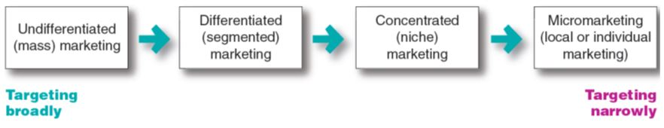
Market Targeting
Selecting Target Market Segments
FIGURE | 7.2
Market-Targeting Strategies
Copyright © 2016 Pearson Education, Inc.
7-27
Notes:
Figure 7.2 shows that companies can target very broadly (undifferentiated marketing), very narrowly (micromarketing), or somewhere in between (differentiated or concentrated marketing).
This figure covers a broad range of targeting strategies, from mass marketing (virtually no targeting) to individual marketing (customizing products and programs to individual customers). An example of individual marketing is candy lovers can buy M&M’s embossed with images of their kids or pets.

Slide 28
Market Targeting
Selecting Target Market Segments
Undifferentiated marketing targets the whole market with one offer.
  Mass marketing
  Focuses on common needs rather than what’s different
Copyright © 2016 Pearson Education, Inc.
7-28
Notes:
With undifferentiated marketing (or mass marketing), the company designs a product and a marketing program that will appeal to the largest number of buyers.
As noted in the chapter, most modern marketers have strong doubts about this strategy. Difficulties arise in developing a product or brand that will satisfy all consumers. Moreover, mass marketers often have trouble competing with more-focused firms that do a better job of satisfying the needs of specific segments and niches.

Slide 29
Market Targeting
Selecting Target Market Segments
Differentiated marketing targets several different market segments and designs separate offers for each.
Goal is to achieve higher sales and stronger position
More expensive than undifferentiated marketing
Copyright © 2016 Pearson Education, Inc.
7-29
Notes:
P&G markets six different laundry detergent brands in the United States, which compete with each other on supermarket shelves. Then, P&G further segments each brand to serve even narrower niches.
Developing a stronger position within several segments creates more total sales than undifferentiated marketing across all segments. Hallmark’s differentiated brands account for more than 44 percent of the greeting cards purchased in the United States. Similarly, P&G’s multiple detergent brands capture four times the market share of its nearest rival.
Differentiated marketing increases the costs of doing business. The company must weigh increased sales against increased costs when deciding on a differentiated marketing strategy.

Slide 30
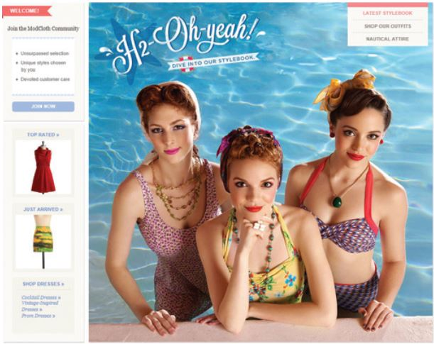
Market Targeting
Selecting Target Market Segments
Concentrated marketing
targets a large of a
smaller market.
Limited company
resources
Knowledge of the market
More effective and efficient
Copyright © 2016 Pearson Education, Inc.
7-30
Notes:
Concentrated marketing: Thanks to the reach and power of online marketing, online women’s clothing nicher ModCloth.com has attracted a devoted following. . Modcloth.com’s has a unique selection of indie clothing, engaging promotions on the ModLife blog and various social media, and Web interactivity.
When using a concentrated marketing (or niche marketing) strategy, a firm goes after a large share of one or a few smaller segments or niches. For example, Whole Foods Market thrives by catering to affluent customers that the Walmarts of the world can’t serve well.
Today, the low cost of setting up shop on the Internet makes it even more profitable to serve seemingly miniscule niches. Small businesses, in particular, are realizing riches from serving small niches on the Web.
Concentrated marketing can be highly profitable. At the same time, it involves higher-than-normal risks. Companies that rely on one or a few segments for all of their business will suffer greatly if the segment turns sour. Or larger competitors may decide to enter the same segment with greater resources. For these reasons, many companies prefer to diversify in several market segments. In fact, many large companies develop or acquire niche brands of their own.

Slide 31
Market Targeting
Selecting Target Market Segments
Micromarketing is the practice of tailoring products and marketing programs to suit the tastes of specific individuals and locations.
  Local marketing
  Individual marketing
Copyright © 2016 Pearson Education, Inc.
7-31
Notes:
Rather than seeing a customer in every individual, micromarketers see the individual in every customer. Micromarketing includes local marketing and individual marketing described on the next slides.

Slide 32
Market Targeting
Selecting Target Market Segments
Local marketing involves tailoring brands and promotion to the needs and wants of local customer segments.
  Cities
  Neighborhoods
  Stores
Copyright © 2016 Pearson Education, Inc.
7-32
Notes:
Local marketing involves tailoring brands and promotions to the needs and wants of local customer groups—cities, neighborhoods, and even specific stores. For example, department store chain Macy’s has rolled out a localization program called My Macy’s in which merchandise is customized under 69 different geographical districts.
Advances in communications technology have given rise to new high-tech versions of location-based marketing. Thanks to the explosion in net-connected
smartphones with GPS capabilities and location-based social networks, companies can now track consumers’ whereabouts closely and gear their offers accordingly.
Increasingly, location-based marketing is going mobile, reaching on-the-go consumers as they come and go in key local market areas.
Discussion Question
What are the drawbacks of local marketing?
Local marketing has some drawbacks. It can drive up manufacturing and marketing costs by reducing the economies of scale. It can also create logistics problems as companies try to meet the varied requirements of different regional and local markets. Still, as companies face increasingly fragmented markets, and as new supporting technologies develop, the advantages of local marketing often outweigh the drawbacks. In addition, a brand’s overall image might be diluted if the product and message vary too much in different localities.

Slide 33
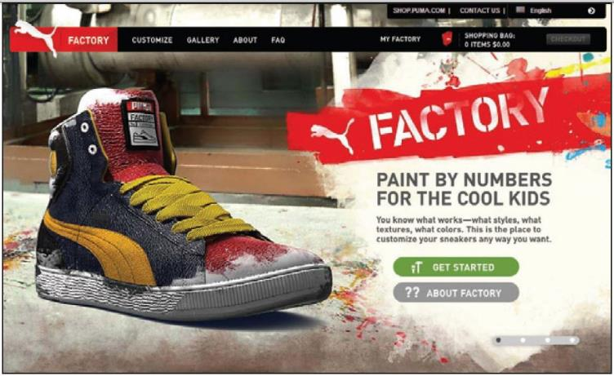
Market Targeting
Selecting Target Market Segments
Individual marketing involves tailoring products and marketing programs to the needs and preferences of individual customers.
Also known as:
  One-to-one marketing
  Mass customization
Copyright © 2016 Pearson Education, Inc.
7-33
Notes:
Individual marketing: The PUMA Factory sneaker customization web site lets customers tailor their PUMA shoes to taste. “You know what works—what
styles, what textures, what colors. Customize your sneakers whatever way you want.”
In the extreme, micromarketing becomes individual marketing— one-to-one or markets-of-one marketing.
More detailed databases, robotic production and flexible manufacturing, and interactive media such as mobile phones and the Internet have combined to foster mass customization. Mass customization is the process by which firms interact one-to-one with masses of customers to design products and services tailor-made to individual needs. Individual marketing has made relationships with customers more important than ever.
The world appears to be coming full circle—from the good old days when customers were treated as individuals to mass marketing when nobody knew your name and then back again.

Slide 34
Market Targeting
Selecting Target Market Segments
Choosing a targeting strategy depends on
  Company resources
  Product variability
  Product life-cycle stage
  Market variability
  Competitor’s marketing strategies
Copyright © 2016 Pearson Education, Inc.
7-34
Notes:
As shown in the slide, companies need to consider many factors when choosing a market-targeting strategy.
When the firm’s resources are limited, concentrated marketing makes the most sense. Undifferentiated marketing is more suited for uniform products, such as grapefruit or steel.
When a firm introduces a new product, it may be practical to launch one version only, as undifferentiated marketing or concentrated marketing may make the most sense. In the mature stage of the product life cycle, however, differentiated marketing often makes more sense.
Undifferentiated marketing is appropriate where there is little market variability - most buyers have the same tastes, buy the same amounts, and react the same way to marketing efforts.
When competitors use undifferentiated marketing, a firm can gain an advantage by using differentiated or concentrated marketing, focusing on the needs of buyers in specific segments.

Slide 35
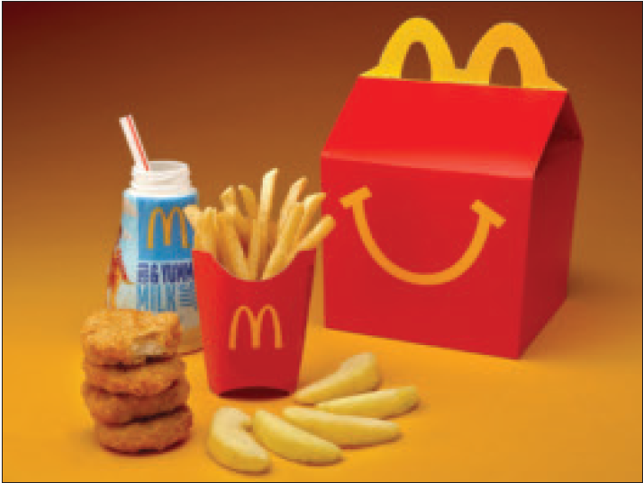
Market Targeting
Selecting Target Market Segments
Socially Responsible Target Marketing
Benefits customers with specific needs
Concern for vulnerable segments
Copyright © 2016 Pearson Education, Inc.
7-35
Notes:
Socially responsible targeting: McDonald’s has responded to the concerns of parents and children’s health advocates by putting the Happy Meal on a diet, cutting the calorie count by 20 percent, adding fruit, and promoting Happy Meals only with milk, water, and juice.
Target marketing sometimes generates controversy and concern. For example, fast-food chains have generated controversy over the years by their attempts to target inner-city minority consumers. They’ve been accused of pitching their high-fat, salt laden fare to low-income, urban residents who are much more likely than suburbanites to be heavy consumers. Similarly, big banks and mortgage lenders have been criticized for targeting consumers in poor urban areas with attractive adjustable-rate home mortgages that they can’t really afford.
Children are seen as an especially vulnerable audience. Marketers in a wide range of industries—from cereal, soft drinks, and fast food to toys and fashion—have been heavily criticized for their marketing efforts directed toward children.
In target marketing, the issue is not really who is targeted but rather how and for what. Controversies arise when marketers attempt to profit at the expense of targeted segments—when they unfairly target vulnerable segments or target them with questionable products or tactics.
Socially responsible marketing calls for segmentation and targeting that serve not just the interests of the company but also the interests of those targeted.

Slide 36
Customer-Driven Marketing Strategy
Learning Objective 3
Explain how companies identify attractive market segments and choose a market-targeting strategy.
Market Targeting
Evaluating Market Segments
Selecting Target Market Segments
Copyright © 2016 Pearson Education, Inc.
7-36
Notes:
Discussion Question
Give an example of the four different market-targeting strategies.
Learning Objective 3 Summary
To target the best market segments, the company first evaluates each segment’s size and growth characteristics, structural attractiveness, and compatibility with company objectives and resources. It then chooses one of four market-targeting strategies—ranging from very broad to very narrow targeting. The seller can ignore segment differences and target broadly using undifferentiated (or mass) marketing. This involves mass producing, mass distributing, and mass promoting the same product in about the same way to all consumers. Or the seller can adopt differentiated marketing—developing different market offers for several segments. Concentrated marketing (or niche marketing) involves focusing on one or a few market segments only. Finally, micromarketing is the practice of tailoring products and marketing programs to suit the tastes of specific individuals and locations. Micromarketing includes local marketing and individual marketing. Which targeting strategy is best depends on company resources, product variability, product life-cycle stage, market variability, and competitive marketing strategies.

Slide 37
Customer-Driven Marketing Strategy
Learning Objective 4
Discuss how companies differentiate and position their products for maximum competitive advantage.
Differentiation and Positioning
Copyright © 2016 Pearson Education, Inc.
7-37

Slide 38
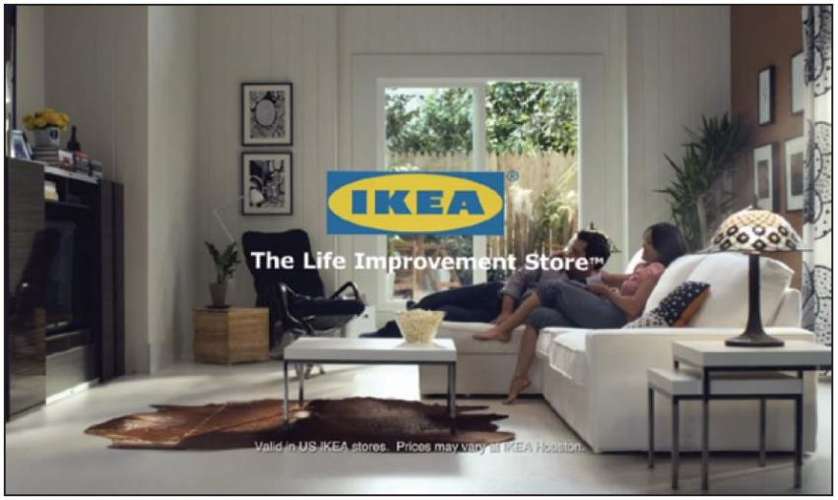
Differentiation and Positioning
Product position is the way the product is defined by consumers on important attributes.
Copyright © 2016 Pearson Education, Inc.
7-38
Notes:
Positioning: IKEA does more than just sell affordable home furnishings; it’s the “Life improvement store.”
The company must decide on a value proposition—how it will create differentiated value for targeted segments and what positions it wants to occupy in those segments. The place the product occupies in consumers’ minds relative to competing products is the position. Products are made in factories, but brands happen in the minds of consumers.
Dreft is positioned as the gentle detergent for baby clothes; at IHOP, you “Come hungry. Leave happy.”; at Olive Garden, “When You’re Here, You’re Family.” In the automobile market, the Nissan Versa and Honda Fit are positioned on economy, Mercedes and Cadillac on luxury, and Porsche and BMW on performance.
To simplify the buying process, consumers organize products, services, and companies into categories and “position” them in their minds. A product’s position is the complex set of perceptions, impressions, and feelings that consumers have for the product compared with competing products.
Consumers position products with or without the help of marketers. But marketers do not want to leave their products’ positions to chance. They must plan positions that will give their products the greatest advantage in selected target markets, and they must design marketing mixes to create these planned positions.

Slide 39
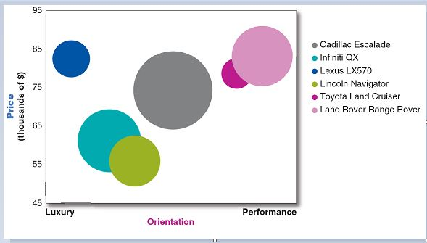
Differentiation and Positioning
Positioning Maps
Positioning maps show consumer perceptions of marketer’s brands versus competing products on important buying dimensions.
Copyright © 2016 Pearson Education, Inc.
7-39
Notes:
In planning their differentiation and positioning strategies, marketers often prepare perceptual positioning maps. The position of each circle on the map indicates the brand’s perceived positioning on two dimensions: price and orientation (luxury versus performance). The size of each circle indicates the brand’s relative market share.

Slide 40
Differentiation and Positioning
Choosing a Differentiation and Positioning Strategy
Identifying a set of possible competitive advantages to build a position
Choosing the right competitive advantages
Selecting an overall positioning strategy
Communicating and delivering the chosen position to the market
Copyright © 2016 Pearson Education, Inc.
7-40
Notes:
Firms must differentiate their offers by building a unique bundle of benefits that appeals to a substantial group within the segment. Above all else, a brand’s positioning must serve the needs and preferences of well-defined target markets.
For example, although both Dunkin’ Donuts and Starbucks are coffee and snack shops, they target very different customers, who want very different things from their favorite coffee seller. Starbucks targets more upscale professionals with more high-brow positioning. In contrast, Dunkin’ Donuts targets the “average Joe” with a decidedly more low-brow, “everyman” kind of positioning. Yet each brand succeeds because it creates just the right value proposition for its unique mix of customers

Slide 41
Differentiation and Positioning
Choosing a Differentiation and Positioning Strategy
Competitive advantage is an advantage over competitors gained by offering consumers greater value, either through lower prices or by providing more benefits that justify higher prices.
Copyright © 2016 Pearson Education, Inc.
7-41
Notes:
To build profitable relationships with target customers, marketers must understand customer needs and deliver more customer value better than competitors do. To the extent that a company can differentiate and position itself as providing superior customer value, it gains competitive advantage.
But solid positions cannot be built on empty promises. If a company positions its product as offering the best quality and service, it must actually differentiate the product so that it delivers the promised quality and service. Companies must do much more than simply shout out their positions with slogans and taglines. They must first live the slogan.

Slide 42

Differentiation and Positioning
Choosing a Differentiation and Positioning Strategy
Identifying a set of possible competitive advantages to differentiate along the lines of:
Product
Services
Channels
People
Image
Copyright © 2016 Pearson Education, Inc.
7-42
Notes:
Product differentiation: Premium audio brand Bose promises “better sound through research—an innovative, high-quality listening experience.”
To find points of differentiation, marketers must think through the customer’s entire experience with the company’s product or service. An alert company can find ways to differentiate itself at every customer contact point.
Through product differentiation, brands can be differentiated on features, performance, or style and design. Thus, Bose positions its speakers on their striking design and sound characteristics. By gaining the approval of the American Heart Association as an approach to a healthy lifestyle, Subway differentiates itself as the healthy fast-food choice.
Some companies gain services differentiation through speedy, convenient, or careful delivery. For example, First Convenience Bank of Texas offers “Real Hours for Real People.” It is open seven days a week, including evenings.
Firms that practice channel differentiation gain competitive advantage through the way they design their channel’s coverage, expertise, and performance. Amazon.com and GEICO, for example, set themselves apart with their smooth-functioning direct channels.
Companies can also gain a strong competitive advantage through people differentiation—hiring and training better people than their competitors do.
Even when competing offers look the same, buyers may perceive a difference based on company or brand image differentiation. The chosen symbols, characters, and other image elements a brand chooses must be communicated through advertising that conveys the company’s or brand’s personality.

Slide 43
Differentiation and Positioning
Choosing a Differentiation and Positioning Strategy
Choosing the Right Competitive Advantage
A difference to promote should be:
Distinctive
Superior
Communicable
Preemptive
Affordable
Profitable
Important
Copyright © 2016 Pearson Education, Inc.
7-43
Notes:
Discussion Question
Are you familiar with GEICO advertisements? If so, what is their positioning?
Not all brand differences are meaningful or worthwhile, and each difference has the potential to create company costs as well as customer benefits. A difference is worth establishing to the extent that it satisfies the following criteria:
Important: The difference delivers a highly valued benefit to target buyers.
Distinctive: Competitors do not offer the difference, or the company can offer it in a more distinctive way.
Superior: The difference is superior to other ways that customers might obtain the same benefit.
Communicable: The difference is communicable and visible to buyers.
Preemptive: Competitors cannot easily copy the difference.
Affordable: Buyers can afford to pay for the difference.
Profitable: The company can introduce the difference profitably.
Many companies have introduced differentiations that failed one or more of these tests. Choosing competitive advantages on which to position a product or service can be difficult, yet such choices may be crucial to success. Choosing the right differentiators can help a brand stand out from the pack of competitors. For example, when Nokia introduced its Lumia 1020 smartphone, it didn’t position the phone only on attributes shared with competing models, such as user interface and speed. It positioned it as a smartphone with a 41 megapixel camera with a “reinvented zoom” and “full HD video” that fits today’s digital lifestyles.

Slide 44
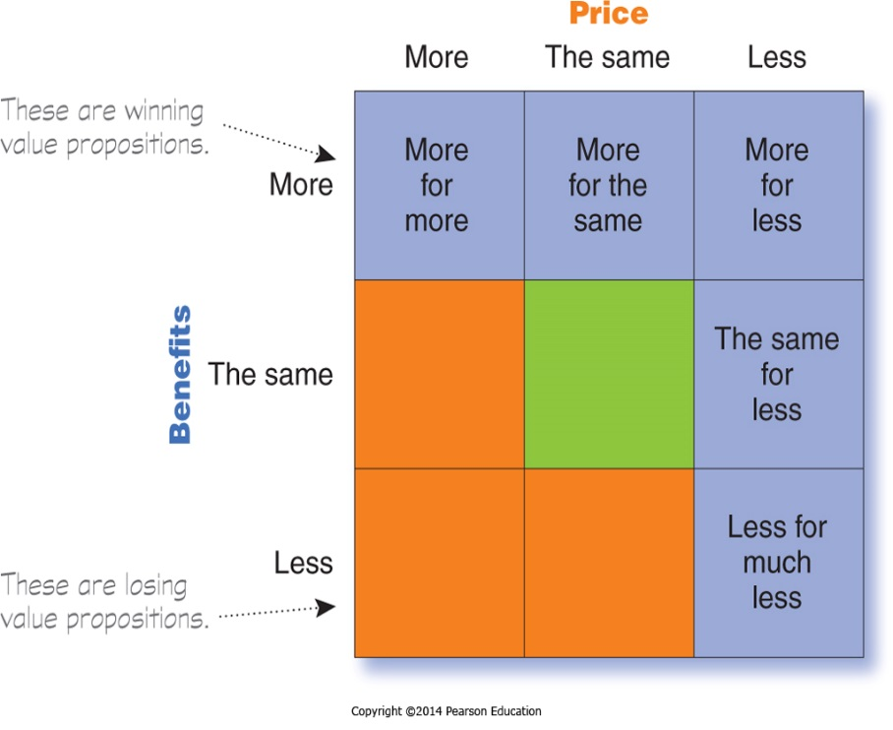
Differentiation and Positioning
Choosing a Differentiation and Positioning Strategy
Selecting an Overall Positioning Strategy
Value proposition is the full mix of benefits upon which a brand is positioned.
Copyright © 2016 Pearson Education, Inc.
7-44
Notes:
The full positioning of a brand is called the brand’s value proposition—the full mix of benefits on which a brand is differentiated and positioned. It is the answer to the customer’s question “Why should I buy your brand?” BMW’s “ultimate driving machine” value proposition hinges on performance but also includes luxury and styling, all for a price that is higher than average but seems fair for this mix of benefits.
Figure 7.4 shows possible value propositions on which a company might position its products. In the figure, the five green cells represent winning value propositions— differentiation and positioning that gives the company a competitive advantage
More for more: This positioning involves providing the most upscale product or service and charging a higher price to cover the higher costs. Although more for more can be profitable, this strategy can also be vulnerable. It often invites imitators who claim the same quality but at a lower price.
More for the same: Companies can attack a competitor’s more for more positioning by introducing a brand offering comparable quality at a lower price. For example, Toyota introduced its Lexus line with a more for the same value proposition versus Mercedes and BMW.
The same for less: Offering the same for less can be a powerful value proposition—everyone likes a good deal. Discount stores such as Walmart and “category killers” such as Best Buy, PetSmart, David’s Bridal, and DSW Shoes use this positioning.
Less for much less: A market almost always exists for products that offer less and therefore cost less. Few people need, want, or can afford “the very best” in everything they buy. In many cases, consumers will gladly settle for less than optimal performance or give up some of the bells and whistles in exchange for a lower price. For example, Family Dollar and Dollar General stores offer more affordable goods at very low prices.
More for less: Of course, the winning value proposition would be to offer more for less. Many companies claim to do this. And, in the short run, some companies can actually achieve such lofty positions. For example, when it first opened for business, Home Depot had arguably the best product selection, the best service, and the lowest prices compared to local hardware stores and other home improvement chains. Offering more usually costs more, making it difficult to deliver on the “for less” promise in the long run.
All said, each brand must adopt a positioning strategy designed to serve the needs and wants of its target markets. More for more will draw one target market, less for much less will draw another, and so on. Thus, in any market, there is usually room for many different companies, each successfully occupying different positions. The important thing is that each company must develop its own winning positioning strategy, one that makes the company special to its target consumers.

Slide 45
Differentiation and Positioning
Choosing a Differentiation and Positioning Strategy
Positioning statement summarizes company or brand positioning using this form: To (target segment and need) our (brand) is (concept) that (point of difference)
Copyright © 2016 Pearson Education, Inc.
7-45
Notes:
The company and brand positioning should be summed up in a positioning statement. An example using the above form is shown on the next slide.
The case for the brand’s superiority is made on its points of difference. For example, the U.S. Postal Service ships packages just like UPS and FedEx, but it differentiates its priority mail from competitors with convenient, low-price, flat-rate shipping boxes and envelopes. “If it fits, it ships,” promises USPS.

Slide 46
Differentiation and Positioning
Choosing a Differentiation and Positioning Strategy
Positioning Statement Example for Evernote:
“To busy multitaskers who need help remembering things, Evernote is a digital content management application that makes it easy to capture and remember moments and ideas from your everyday life using your computer, phone, tablet, and the Web.”
Copyright © 2016 Pearson Education, Inc.
7-46
Notes:
Here is a positioning statement example using the popular digital information management application, Evernote: “To busy multitaskers who need help remembering things, Evernote is a digital content management application that makes it easy to capture and remember moments and ideas from your everyday life using your computer, phone, tablet, and the Web.”
Note that the positioning statement first states the product’s membership in a category (digital content management application) and then shows its point of difference from other members of the category (easily capture moments and ideas and remember them later). Evernote helps you “remember everything” by letting you take notes, capture photos, create to-do lists, and record voice reminders, and then makes them easy to find and access using any device, anywhere—at home, at work, or on the go.

Slide 47
Communicating and Delivering the Chosen Position
Differentiation and Positioning
Choosing the positioning is often easier than implementing the position.
Establishing a position or changing one usually takes a long time.
Maintaining the position requires consistent performance and communication.
Copyright © 2016 Pearson Education, Inc.
7-47
Notes:
Once it has chosen a position, the company must take strong steps to deliver and communicate the desired position to its target consumers. All the company’s marketing mix efforts must support the positioning strategy. Positioning the company calls for concrete action, not just talk. If the company decides to build a position on better quality and service, it must first deliver that position.
Companies must closely monitor and adapt the position over time to match changes in consumer needs and competitors’ strategies. However, the company should avoid abrupt changes that might confuse consumers, and should evolve gradually as it adapts to the ever-changing marketing environment.

Slide 48
Customer-Driven Marketing Strategy
Learning Objective 4
Discuss how companies differentiate and position their products for maximum competitive advantage.
Differentiation and Positioning
Positioning Maps
Choosing a Differentiation and Positioning Strategy
Communicating and Delivering the Chosen Position
Copyright © 2016 Pearson Education, Inc.
7-48
Notes:
Discussion Question
What criteria should be evaluated in determining which differences a company should promote in its products?
Learning Objective 4 Summary
Once a company has decided which segments to enter, it must decide on its differentiation and positioning strategy. The differentiation and positioning task consists of three steps: identifying a set of possible differentiations that create competitive advantage, choosing advantages on which to build a position, and selecting an overall positioning strategy.
The brand’s full positioning is called its value proposition—the full mix of benefits on which the brand is positioned. In general, companies can choose from one of five winning value propositions on which to position their products: more for more, more for the same, the same for less, less for much less, or more for less. Company and brand positioning are summarized in positioning statements that state the target segment and need, the positioning concept, and specific points of difference. The company must then effectively communicate and deliver the chosen position to the market.

Slide 49
Principles of Marketing
PowerPoint Copyright Page
7-49

